Slide 1
Lecture 5 (Chapter 6)
Objectives
Explain the mechanism of convection heat transfer in a fluid over a surface (external convection) in terms of a stagnant fluid layer over the surface called the boundary layer
Calculate/predict convective heat transfer coefficients h knowing the flow situation

Slide 2
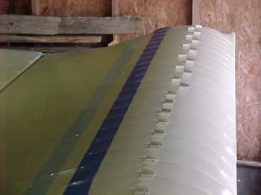


Stagnant Layer
NASA Information

Slide 3
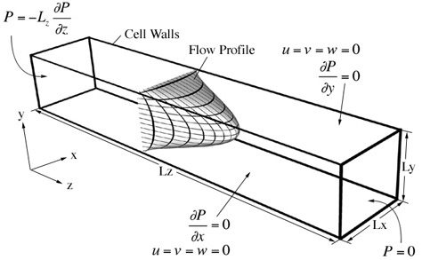

Concepts on Convection
Convection is associated to a flow motion (fluid velocity)
The fluid motion (velocity) is able to transfer energy by mixing
Transfer of energy by convection should associate the velocity of the fluid with the temperatures of the fluid and the surface
Fluid Velocity is a vector variable whereas temperature is a scalar
In this case, velocity has only one significant
component in the direction z, which is u_{z}
In this case velocity has two significant components in the directions x and y, which are
u_{x} and u_{y}
y
x

Slide 4
Concepts on Convection
In general fluid velocity is a three direction vector
e_{z}
u_{z}
e_{y}
u_{y}
How could we relate the fluid velocity (a vector) with the temperature (a scalar)?
u_{x}
e_{x}

Slide 5
Concepts on Convection
(A scalar)
If the velocity components are constant
(A scalar)
(A scalar)

Slide 6
BALANCE ENERGY EQUATION
Convection
Simplified Equation – 1D heat transfer – fluid velocity constant u_{x}=u
Convection
Complex Equation – 2D or 3D heat transfer – fluid velocity “vector” function of
position
Convection
Vector that can be obtained from the
fluid motion equations. Fluid velocity must be known

Slide 7
Boundary Layer Concept
NASA Information

Slide 8


Temperature Profiles and Boundary Layer over a Surface
Velocity
boundary
layer
Thermal
boundary
layer
Velocity
Profile
y
x
Temperature
profile
Velocity boundary layer
Temperature boundary layer
value of
y at which

Slide 9
Temperature Profiles and Boundary Layer over a Surface
Small gradients
of temperature
and velocity
Velocity
boundary
layer
Thermal
boundary
layer
Velocity
Profile
y
x
Temperature
profile
Velocity boundary layer exists if there is flow
Temperature boundary layer exists as long there is a temperature difference
between the solid and the bulk fluid
Large gradients in temperature
and velocity

Slide 10
Temperature Profiles and Boundary Layer over a Surface
Velocity
boundary
layer
Thermal
boundary
layer
Velocity
Profile
y
x
Temperature
profile
Fluid-dynamic Problem
Energy Problem
Reynolds Number
Prandtl Number
Fluid Density
Distance along the flow
from the leading edge
of the plate
Fluid Viscosity

Slide 11
Temperature Profiles and Boundary Layer over a Surface
For Laminar Flow
Using water properties Pr = 5
Using air properties Pr = 1

Slide 12
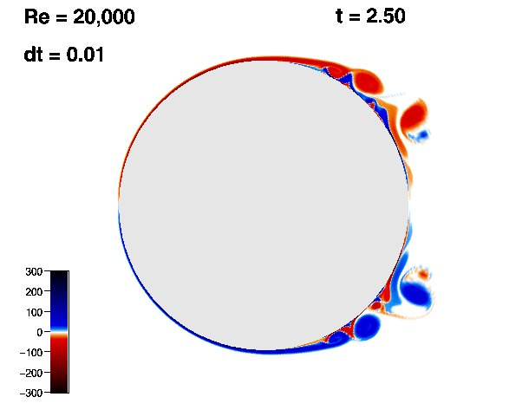
LAMINAR AND TURBULENT FLOWS
Laminar
Transition
Turbulent

Slide 13
Heat, q
Cold Air,T_{air}
Hot Surface,T_{S}
Heat, q

Slide 14
Definition of Convective Heat Transfer Coefficient
y
The boundary layer is stagnant
“There is no fluid motion”
at the interface and the heat
is transferred only by conduction
x
Conductive heat transfer in the fluid
Convective heat transfer in the fluid
compare
Local heat transfer
coefficient

Slide 15
Definition of Convective Heat Transfer Coefficient
increases with x
decreases with x
decreases with x
y
x
Average Convective
coefficient

Slide 16
Definition of Convective Heat Transfer Coefficient
y
x
if h varies only with x
x
w
A_{s}
L

Slide 17
Rigorous Solution of Convective Heat Transfer
Let’s consider a 2D – Steady state rectangular problem
Energy Equation (steady state and no heat generation)
Linked equations
are function
of T
Motion Equations

Slide 18
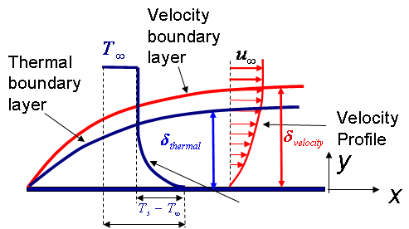
Simplified Solution of Convective Heat Transfer
A few considerations to use to simplify problem
Kinematic Viscosity

Slide 19
Solution of Convective Heat Transfer
Energy Equation
Fluid motion equation
It is simpler to work with non-dimensional equations

Slide 20
Solution of Convective Heat Transfer

Slide 21
Solution of Convective Heat Transfer

Slide 22
Convective Heat Transfer

Slide 23
Convective Heat Transfer
Local coefficient
Average coefficient

Slide 24
Convective Heat Transfer Coefficient Calculation
Dimensionless Number | Definition and Physical Significance
Reynolds number
Nusselt number
Prandtl number
Biot number
Grashof number
Rayleigh number

Slide 25
Some Comments on Convection Coefficient Values
Correlations could be for a local h(x) or for the average h_{L} over a certain length
Local
Average

Slide 26
Some Comments on Convection Coefficient Values
Properties of the fluid vary with temperature
Properties of the fluid should be calculated at the film temperature
Film temperature

Slide 27
Calculation of convective
heat transfer coefficients
Flat Plate – Forced Convection
for laminar
for laminar
for turbulent
for turbulent

Slide 28

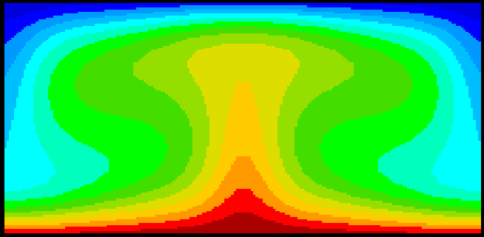
Calculation of convective
heat transfer coefficients
Natural Convection
Low Rayleigh (Ra) number
High Rayleigh (Ra) number
Hot Plate
for gas ideal

Slide 29
Calculation of convective
heat transfer coefficients
Flat Plate – Natural Convection
Vertical Surface
Fluid at
rest at
Fluid movement
due to buoyancy
Surface at

Slide 31
Calculation of convective
heat transfer coefficients
Flat Plate – Natural Convection
Horizontal Surface
Hot side facing up
Red – high Temperature
Blue – low temperature
Hot side facing down

Slide 32
Laminar versus Turbulent Flow
Laminar
Transition
Turbulent

Slide 33
Order of magnitude of h
Free convection, air
Forced convection, air
Forced convection, water
Boiling water
Condensing water vapor
1
10
100
1,000
10,000
100,000

Slide 34
Wind Chill Factor
skin surface
Actual situation
Wind Chill equivalent

Slide 35
Wind Chill Factor
0 mph
15 mph
5 mph
25 mph
35 mph
Wind Chill Temperature
Ambient Temperature

Slide 36
Example
(1) Calculate the average heat transfer coefficient along the 10m width of the wall
(2) Calculate the local heat transfer coefficient at a location 10cm from the leading edge

